Slide 1
Arduino Workshop
Treobytes Mesa Camp

Slide 2
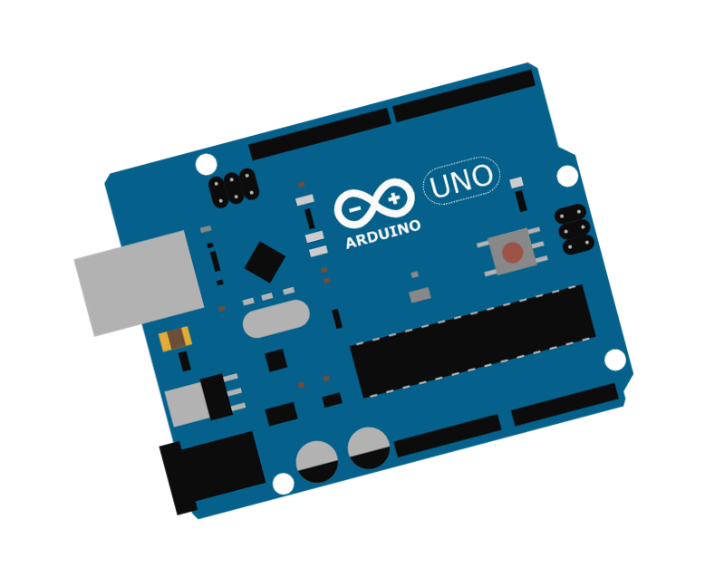
What is an Arduino?
Arduino is an open-source platform used for building electronics projects. Arduino consists of both a physical programmable circuit board (often referred to as a microcontroller) and a piece of software, or IDE (Integrated Development Environment) that runs on your computer, used to write and upload computer code to the physical board.
What does this mean...?
Arduino is a microcontroller that helps connect your hardware to your code. It's a very simple tool that allows you to create a wide array of cool and complex projects!

Slide 3
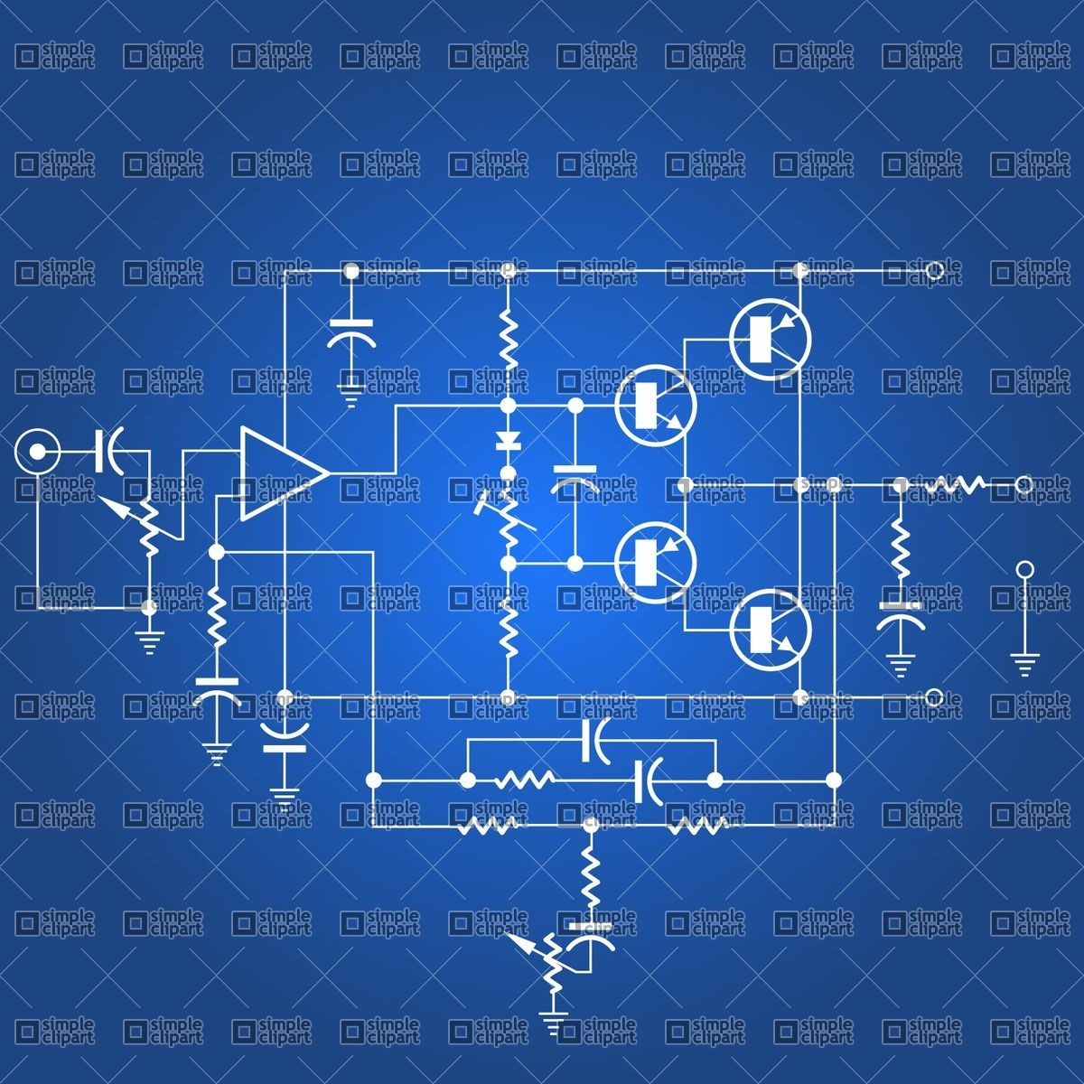
What’s a Circuit?
●A circuit is very similar to a tube with flowing water. Voltage is like the gravitational energy that causes the water to move from a higher position to a lower one.
●Electricity always flows from a higher voltage to a lower voltage. We use ground as our low voltage point

Slide 4
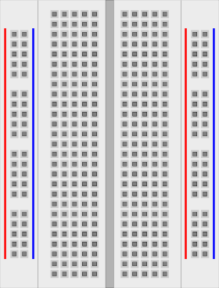
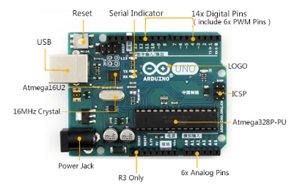
Using Arduinos and Breadboards for Circuits
●Vertical section-holes connected from top to bottom
●Horizontal section-holes in row connected through

Slide 5
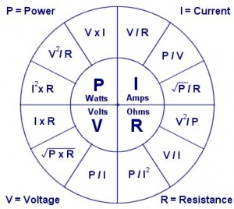
Some Important Equations!
Power (P): the rate (energy amount per time period) at which work is done or energy converted. Measured in Watts (W)
Current (I):is a flow of electrical charge carriers, usually electrons or electron-deficient atoms. Measured in Amps (A)
Voltage (V): electric potential energy per unit charge. Measured in volts (V)
Resistance (R) : the ratio of the voltage applied to the electric current which flows through it. Measured in ohms (Ω)

Slide 6
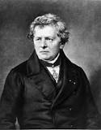
Ohm’s Law
V = IR
Allows us to change the current or voltage
by changing the resistance.

Slide 7
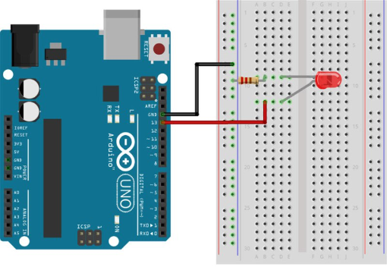
Let’s Build a Circuit
Circuit Diagram -
LED is connected to Pin 12
When the power supply is on
the LED should be lit.

Slide 8
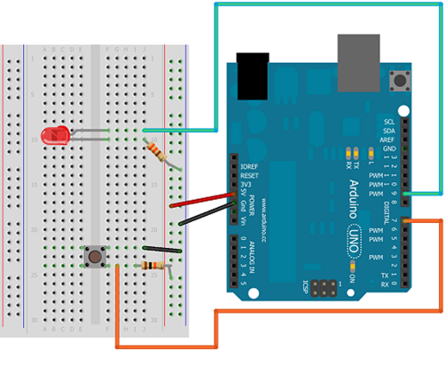
Let’s Add a Button
This will allow us to turn the light
on and off.

Slide 9
Now Let’s Add the Code
AT TOP
const int buttonPin = 7;
const int ledPin = 9;
int buttonState = 0;
IN SETUP()
pinMode(ledPin, OUTPUT);
pinMode(buttonPin, INPUT);

Slide 10
More Code
IN LOOP
buttonState = digitalRead(buttonPin);
if(buttonState == HIGH) {
// Turn the LED on
}
else {
// Turn the LED off
}

Slide 11
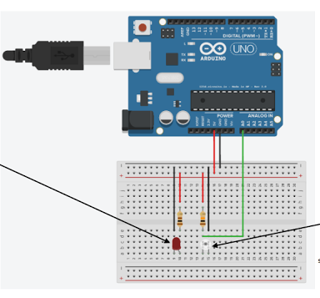
Uploading the Code onto the Arduino
Connect your Arduino to your computer using the USB to microUSB connector.
Go to tools → Make sure board says Arduino Uno → Make sure a port is connected → Go to Sketch → Click Upload

Slide 12
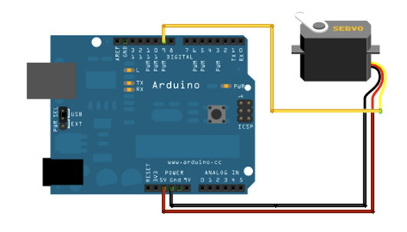
Let’s Build a Robot Claw
First we’re gonna connect a
servo to our Arduino. A servo
is a device that allows motion
in a precise angular/ linear
motion.

Slide 13
The Code
Go to File-->Examples-->Servo-->Sweep to test it out.
AT TOP
Servo servo1; // Declares a servo object
int servoPin = //TODO - Fill with your own servo pin
IN SETUP()
servo1.attach(servoPin) // Attaches the Servo object to a pin
servo1.write(90) // Rotates the Servo to 90 degrees

Slide 14
More Code
IN LOOP
for(int i = 0; i <= 180; i++) { // Start, End, Increment
servo.write(i); // Writes to an angle
delay(15) // Delay by 15 milliseconds
}

Slide 15
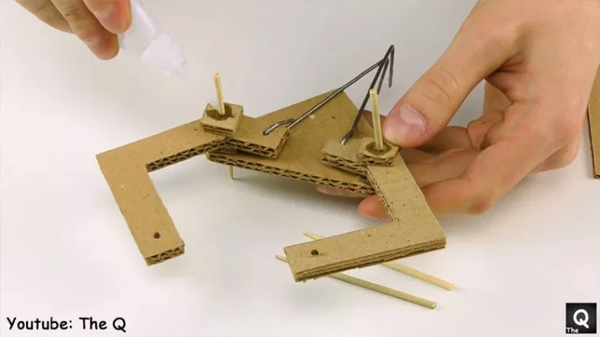
Making the Claw
For the claw we’re using one motor. So we’ll want to have a fixed arm and a moving arm. However, the design is completely up to you!

Slide 16
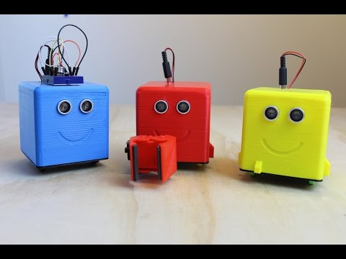
Little Bot

Slide 17
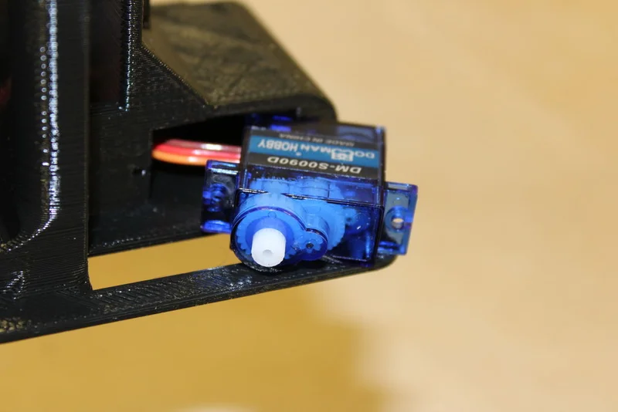
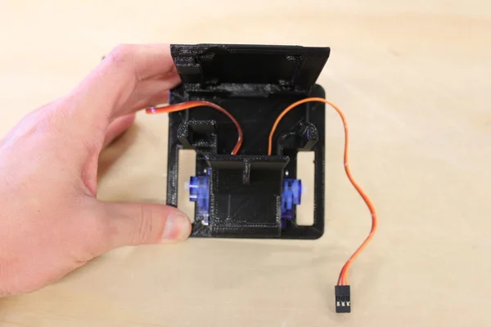
Assembling the Little Bot
Place the servos into the cahsee. Make sure to pull the wires through to the center of the cahsee.

Slide 18
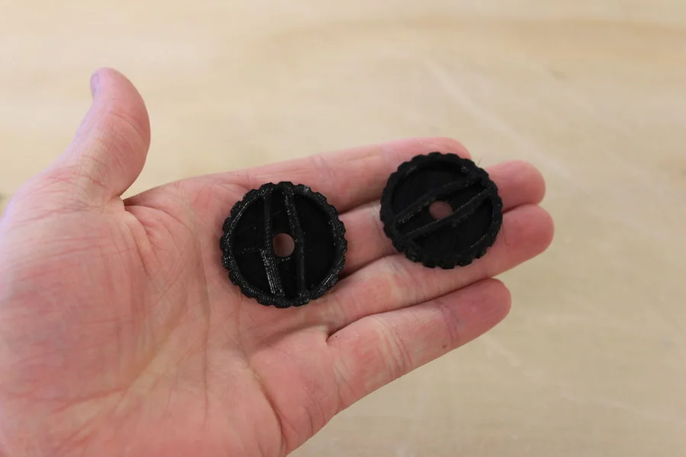
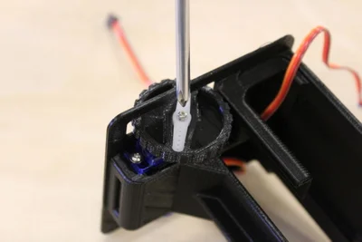
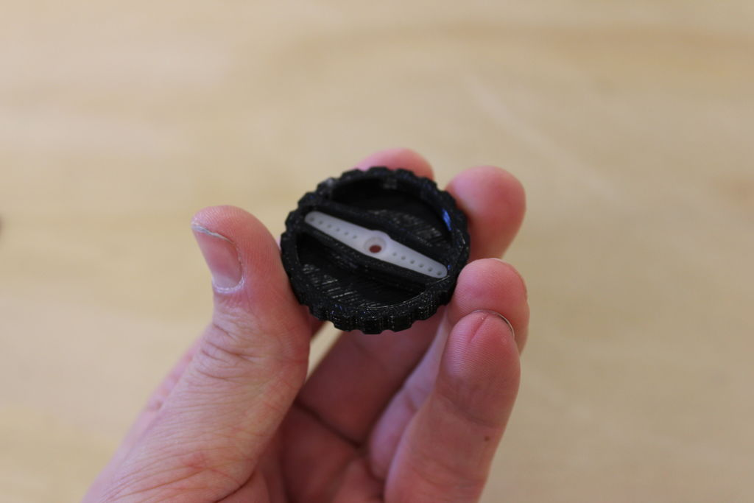
Attaching the Wheels

Slide 19
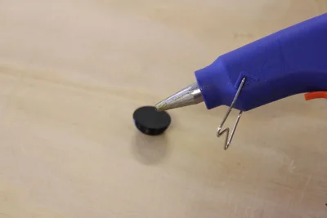
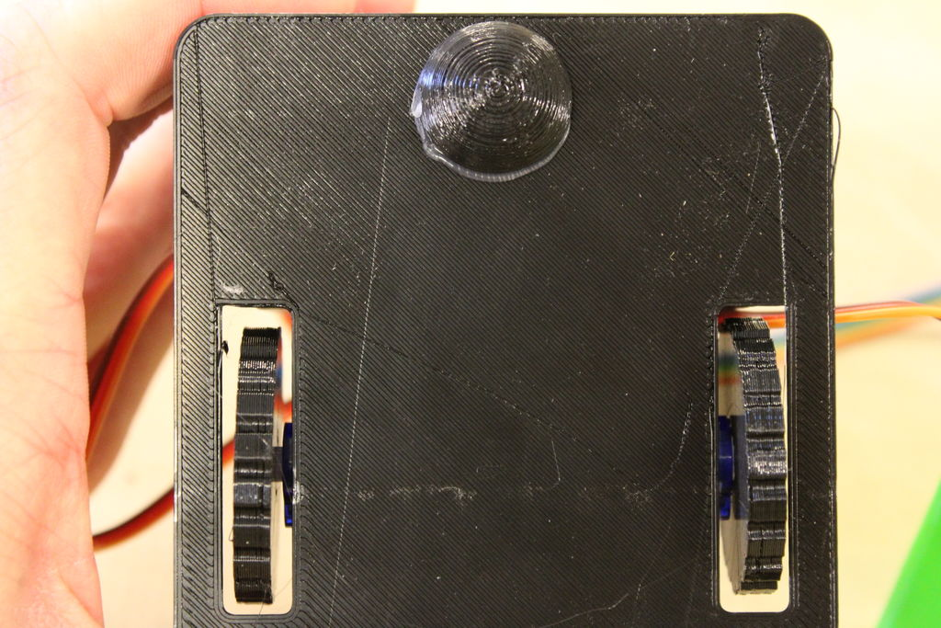
Attaching the Swivel Piece

Slide 20
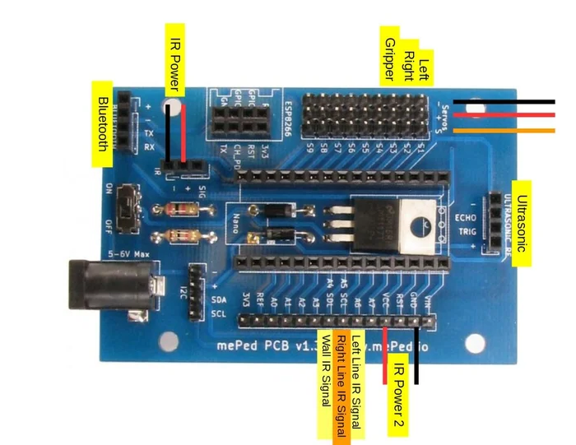
Assembling Circuit
For our little bot we are going
to ignore the ultrasonic
sensors.

Slide 21
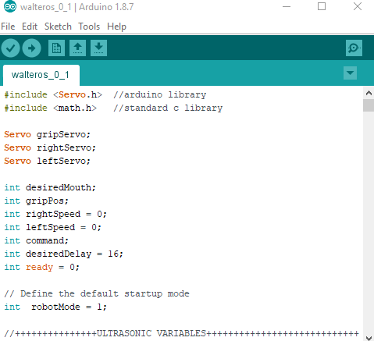
Uploading the Code
We’ll be giving you the code for the littlebots. It should be saved in your files. Open the Arduino IDE and open the file walteros_05.2.ino
Do not try to upload to the arduino when the bluetooth is connected. USB and Bluetooth cancel each other.

Slide 22
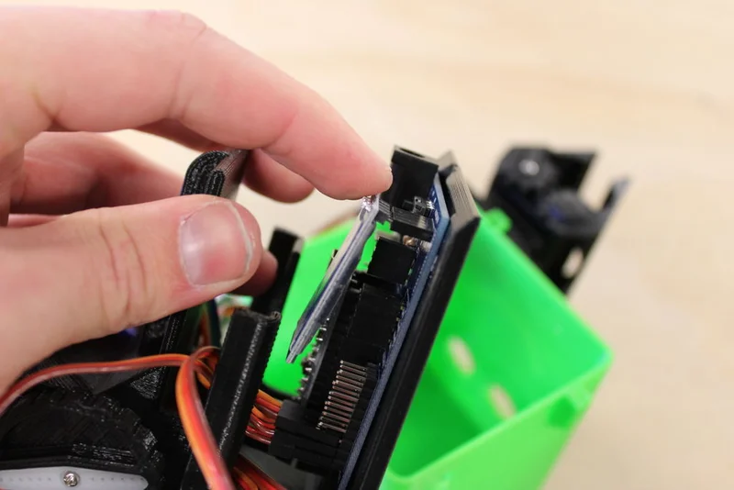
Securing the Electronics
Slide the board into the slots at the back of the base.You can secure the board with a servo mounting screw in the upper-righthand corner of the board if you want to.
Once you have secured the board. Plug in the Bluetooth module

Slide 23
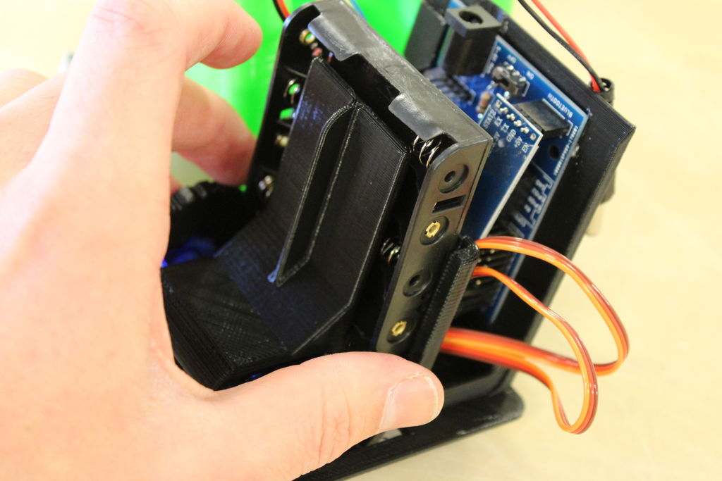
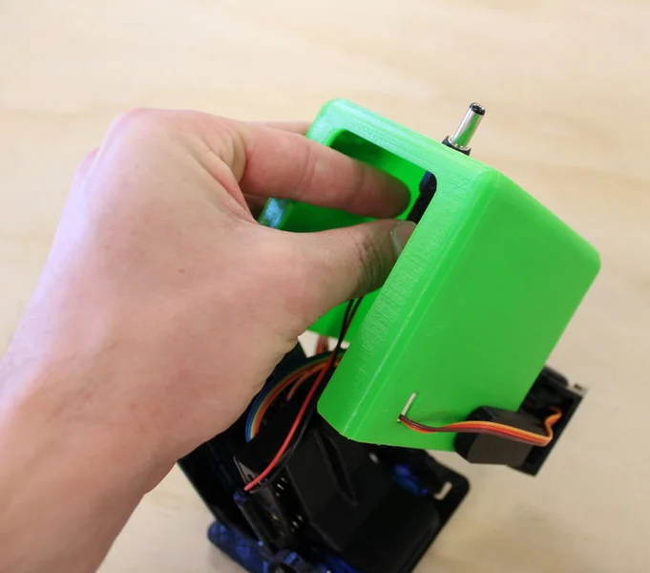
Insert Power Supply and Seal it Up

